Slide 1
Introduction to Applet Programming
Writing Applets
Other Applet Class Functionality
Graphics and Double Bufferring
Creating a User Interface Using the AWT

Slide 2
Introduction
Applet is a java program that can be embedded into HTML pages.
Java applets runs on the java enabled web browsers such as mozila and internet explorer.
Applet is designed to run remotely on the client browser, so there are some restrictions on it.
Applet can't access system resources on the local computer.
Applets are used to make the web site more dynamic and entertaining.

Slide 3
Advantages of Applet
Applets are cross platform and can run on Windows, Mac OS and Linux platform
Applets runs in a sandbox, so the user does not need to trust the code, so it can work without security approval
Applets are supported by most web browsers
Applets are cached in most web browsers, so will be quick to load when returning to a web page .

Slide 4
Writing Applets
Instead of writing a program that has a main() method as in the case of an application, applets are any class that subclasses the Applet class and override some of its methods.
A simple Applet
  import java.awt.*;
  import java.applet.*;
  class HelloWorldApplet extends Applet{ // Default constructor public void HelloWorld()
  { // Call parent constructor super(); }
  public void paint ( Graphics g )
  {
  g.setBackground ( Color.white );
  g.setColor ( Color.blue );
  g.drawString ( "Hello world!", 0, size().height - 5);
  }
  }

Slide 5
Writing Applets
The <Applet> Tag
Here is an example of a simple APPLET tag:
<applet code="MyApplet.class" width=100 height=140></applet>
This tells the viewer or browser to load the applet whose compiled code is in MyApplet.class (in the same directory as the current HTML document), and to set the initial size of the applet to 100 pixels wide and 140 pixels high.

Slide 6
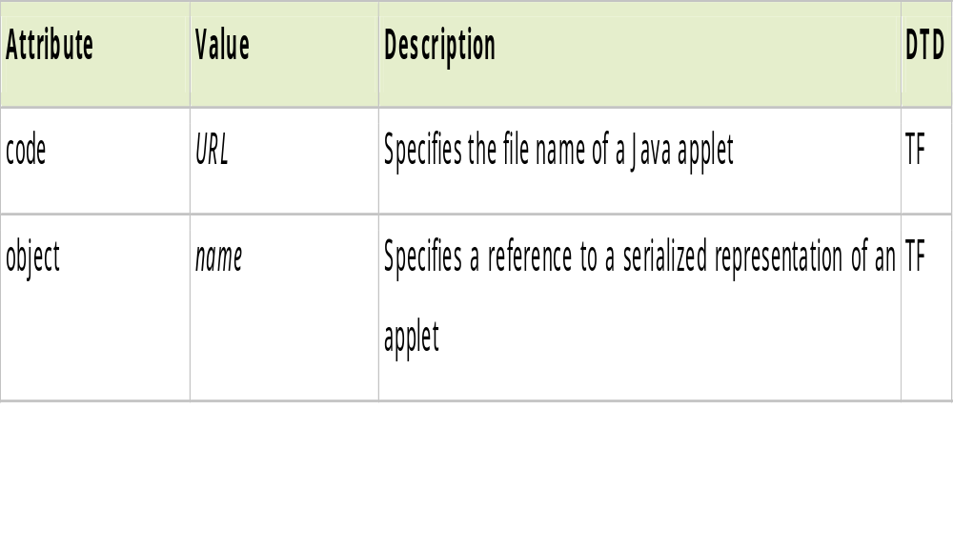
Writing Applets
The <Applet> Tag
Here is an example of a simple APPLET tag:
<applet code="MyApplet.class" width=100 height=140></applet>

Slide 7
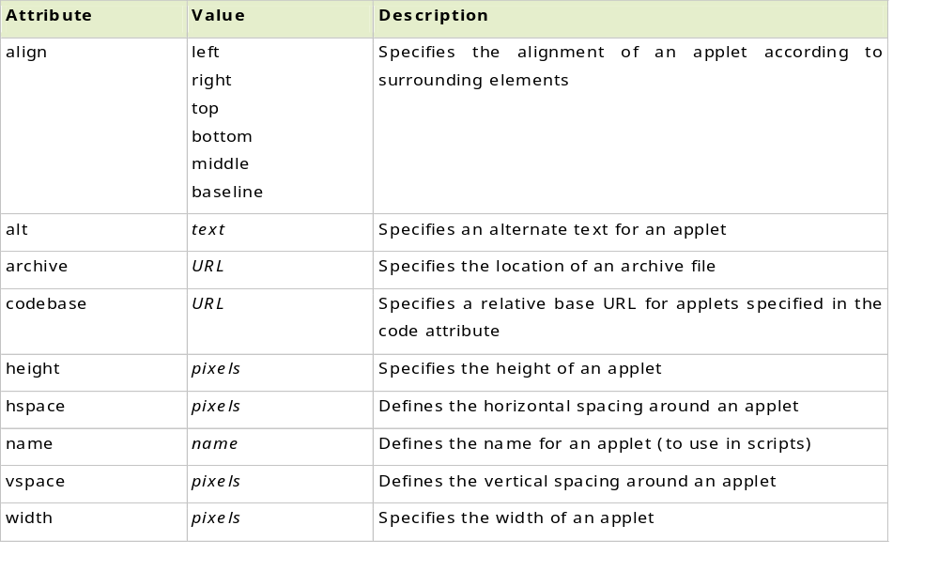
Writing Applets
Optional Attributes

Slide 8
The <Object> Tag
The <object> tag replaces <applet> in html 4.0.
In this example, the CLASSID is used to specify the name of the java code to execute.
<Object CLASSID = “java:HelloWorld.start” height=100 width=100>
</Object>
The <Param> tag
<Param> tags can be placed within the <Applet> or new <Object> tag to send additional information to the applet.

Slide 9
Example:
  Public class Salutation extends Applet
  {
  Private String s;
  Public void init()
  {
  s = getParameter(“salutation”);
  }
  Public void paint(Graphics g)
  {
  g.drawString(salutation,10,10);
  }
  }

Slide 10
The <Object> Tag
The Html code:
  <Applet code=”Salutation.class” width=200 height=250>
  <param name=”salutation” value=”Greetings and Saltutations”> </param>
  </Applet>

Slide 11
Applet methods (Applet Life Cycle Methods)
A list of the applet methods that can be overridden are as follows:
init() - This method is called after the web page containing an applet is loaded into a browser.
start() - This method is called every time the user comes back to the web page containing the applet.
stop () - This method is called every time the user leaves the web page containing the applet.
paint () - This method is called any time the applet’s repaint() method is called.
Update() - This method is called every time the applet is repainted. By default, it erases the entire screen.

Slide 12
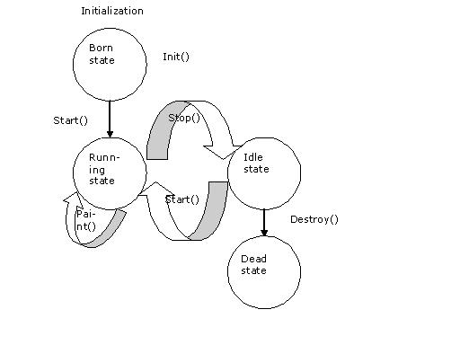
Applet Life Cycle

Slide 13
Resources Available to Applets
A number of resources are available to applets.
The methods that provide access to resources are:
  AudioClip getAudioClip() - This method can be used to load an audio clip from a URL.
  Image getImage() - This method is used to load images from an URL.
  Void play(URL url) - This methods plays a loaded audio clip.

Slide 14
Resources Available to Applets
Methods that provide access to information about an applet are:
  URL getCodeBase() - This method returns the URL from which the applet’s class files were loaded.
  URL getDocumentBase() - This method returns the URL from which the applet’s HTML document was loaded.
  AppletContext getAppletContext() - This method returns an object of type AppletContext. An AppletContext object is useful for loading and viewing web pages.
  showStatus( String msg) - This method displays the msg in the browser’s status bar.
  resize() - This method resizes the applet’s bounds.

Slide 15
Graphics and Double Buffering
Some of the most commonly used methods of Graphics class are:
void drawstring(String string, int x, int y) - Draws a string to the screen at the x, y coordinates.
void clearRect(int x, int y, int width, int height) - Clears a rectangle on the screen with its top-left corner located at x,y and the specified width and height.
void fillRect (int x, int y, int width, int height) - Fills a rectangle on the screen with its top-left corner located at x,y and the specified width and height.
void drawRect (int x, int y, int width, int height) - Draws a rectangle on the screen with its top-left corner located at x,y and the specified width and height.
Void dispose() - Frees resources associated with a graphics context.

Slide 16
Graphics and Double Buffering
Example
  import java.awt.*;
  import java.applet.*;
  public class graph_ex extends Applet
  {
  public void paint (Graphics g)
  { setBackground(Color.cyan);
  g.drawString("Here are a selection of blank shapes.",20,40);
  g.drawLine(20,40,200,40);
  g.setColor(Color.blue);
  g.drawLine(20,50,70,90);
  g.setColor(Color.red);
  g.drawRect(100,50,32,55);
  g.setColor(Color.green);
  g.drawOval(150,46,60,60);
  g.setColor(Color.magenta);

Slide 17
Graphics and Double Buffering
g.drawArc(230,50,65,50,30,270);
g.setColor(Color.black);
g.drawString("Here are the filled equivalents.",20,140);
g.drawLine(20,140,200,140);
g.setColor(Color.yellow);
g.fillRect(100,150,32,55);
g.setColor(Color.pink);
g.fillOval(150,146,60,60);
g.setColor(Color.darkGray);
g.fillArc(230,150,65,50,30,270);
}
}

Slide 18
Double Buffering
Drawing in applets is almost always done with double-buffering.
This means that drawing is first done to an offscreen image, and when all
is done, the offscreen image is drawn on the screen.
This reduces the nasty flickering applets otherwise have.
import java.applet.*;
import java.awt.event.*;
import java.awt.*;
public class DoubleBuffering extends Applet implements MouseMotionListener
{
Graphics bufferGraphics;
Image offscreen;
Dimension dim;
int curX, curY;

Slide 19
Double Buffering
public void init()
{
dim = getSize();
// We'll redraw the applet eacht time the mouse has moved.
addMouseMotionListener(this);
setBackground(Color.black);
offscreen = createImage(dim.width,dim.height);
// by doing this everything that is drawn by bufferGraphics
// will be written on the offscreen image.
bufferGraphics = offscreen.getGraphics();
}

Slide 20
Double Buffering
public void paint(Graphics g)
{
// Wipe off everything that has been drawn before
// Otherwise previous drawings would also be displayed.
bufferGraphics.clearRect(0,0,dim.width,dim.width);
bufferGraphics.setColor(Color.red);
bufferGraphics.drawString("Bad Double-buffered",10,10);
// draw the rect at the current mouse position
// to the offscreen image
bufferGraphics.fillRect(curX,curY,20,20);
// draw the offscreen image to the screen like a normal image.
// Since offscreen is the screen width we start at 0,0.
g.drawImage(offscreen,0,0,this);
}

Slide 21
Double Buffering
public void update(Graphics g)
{
paint(g);
}
// Save the current mouse position to paint a rectangle there.
// and request a repaint()
public void mouseMoved(MouseEvent evt)
{
curX = evt.getX();
curY = evt.getY();
repaint();
}
public void mouseDragged(MouseEvent evt)
{
}
}

Slide 22
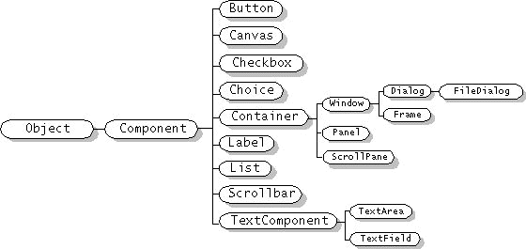
Creating a User Interface Using the AWT
The following figures show the inheritance hierarchies for all the AWT component classes.

Slide 23
Creating a User Interface Using the AWT
The basic structure of an applet that uses each of these predefined methods is:
import java.applet.Applet;
import java.awt.*;
public class AppletTemplate extends Applet {
public void init() {
// create GUI, initialize applet
}
public void start() {
// start threads, animations etc...
}
public void paint(Graphics g) {
// draw things in g
}

Slide 24
Creating a User Interface Using the AWT
public void stop() {
// suspend threads, stop animations etc...
}
public void destroy() {
// free up system resources, stop threads
}
}

Slide 25
Creating a User Interface Using the AWT
  import java.applet.*;
  import java.awt.event.*;
  import java.awt.*;
  public class calc extends Applet implements ActionListener{
  TextField tf1, tf2, tf3;
  Label l1,l2,l3;
  String Add, Subtract,Multiply,Divide;
  public void init(){
  tf1 = new TextField(10);
  tf2 = new TextField(10);
  tf3 =new TextField(10);
  l1 = new Label("Number 1");
  l2 = new Label("Number 2");
  l3 = new Label("Result");

Slide 26
Creating a User Interface Using the AWT
  add(l1); add(tf1);
  add(l2); add(tf2);
  add(l3); add(tf3);
  Button b = new Button("Add");
  Button c = new Button("Subtract");
  Button d = new Button("Multiply");
  Button e = new Button("Divide");
  b.addActionListener(this);
  c.addActionListener(this);
  d.addActionListener(this);
  e.addActionListener(this);
  add(b); add(c);
  add(d); add(e);
  }

Slide 27
Creating a User Interface Using the AWT
public void actionPerformed(ActionEvent e)
{
String s=e.getActionCommand();
int n1 = Integer.parseInt(tf1.getText());
int n2 = Integer.parseInt(tf2.getText());
if(s=="Add")
tf3.setText(String.valueOf(n1+n2));
if(s=="Subtract")
tf3.setText(String.valueOf(n1-n2));
if(s=="Multiply")
tf3.setText(String.valueOf(n1*n2));
if(s=="Divide")
tf3.setText(String.valueOf(n1/n2));
}
}

